Slide 1
Introduction
Notes:
Hello, I am Jahee Kim, who will teach the Data Structures lecture this semester.
First of all, welcome to the Data Structures class.
Do you know what data structures are?
What can you really learn from this class?
How will the class be conducted?
Do you have a lot of homework?
I think today's lecture will answer these questions.
안녕하십니까, 저는 자료구조 및 알고리즘 강의를 맡은 김자희입니다.
먼저 자료구조 및 알고리즘 수업에 오신 걸 환영합니다.
여러분은 왜 이 과목을 선택하셨나요?
과연 이 수업을 통해서 무엇을 배울 수 있을까요?
수업은 어떤 식으로 진행이 될까요?
숙제는 많을까요?

Slide 2
Administration
Team Project
Group Activity
Review
Notes:
This is the agenda for this week.
First, I will explain the plan I will administrate this class.
Next, I will let you know what the team project is.
Finally, I conclude with the review.
The activities are replaced with the quiz. Please check the exam board.

Slide 3
Administration
Notes:
The first section is about administration.

Slide 4
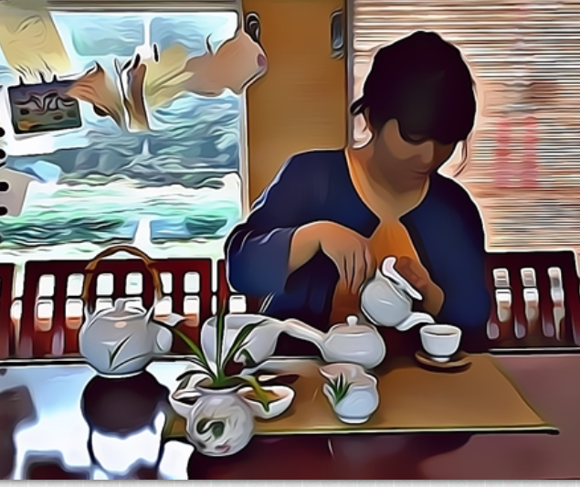
Lecturer
Ja-Hee Kim
Contact Info.
E-mail: jahee@seoultech.ach.kr
If you have any question,
Office Hour: Wednesday 14:00-15:00
Office: Frontier Building #609
Hour: Wednesday 14:00-15:00
Register via message in e-class
Notes:
First of all, my name is Jahee Kim, who will teach this course. Counseling on this lecture is available online or offline. If you would like to visit in person, please come to Frontier Building Room 609 on Wednesdays.
From my experience, most students seem to prefer the message function in e-class system.
If you select the envelope icon in the upper right corner of this class, you can write a message. Then, I will answer it through e-class. If you would like a face-to-face consultation, please use this message feature to reserve a consultation date. Online consultation is also available if necessary.
먼저 본 과목을 강의할 제 이름은 김자희입니다. 교과목에 대한 상담은 온라인 혹은 오프라인으로 가능합니다. 만일 직접 방문하고 싶으시면 프론티어관 609호로 수요일에 오시면 되고, 온라인으로 상담하고 싶으시면 월요일 오후 두시에 이 사이트로 접속하시면 됩니다. 원활한 상담을 위해서는 이클래스의 쪽지 기능을 이용하여 미리 예약해 주십시오. 즉, 이클래스에서 오른쪽 위의 편지봉투 아이콘을 선택하면 다음 화면이 뜹니다. 그럼 여기서 쪽지의 쪽지쓰기 기능을 이용하여 상담을 예약하십시오. 특히 온라인 상담의 경우는 예약이 필수입니다.

Slide 5
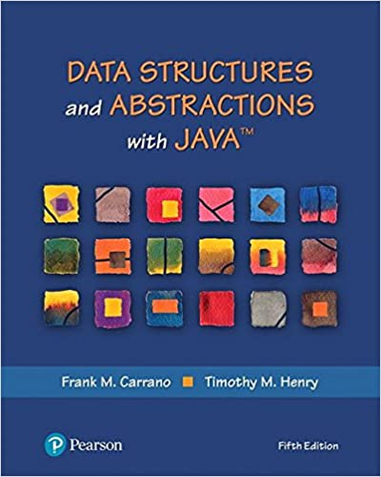

Textbook
https://www.amazon.com/Structures-Abstractions-Whats-Computer-Science/dp/0134831691
Notes:
I will use the 5th edition of Data structures and abstractions with JAVA by Frank M. Carrano and Timoth M.Henry for the course material. If you go to this Amazon link, you will find detailed information about the textbook. If you are a Korean, this Korean book can also be helpful.
강의 교재는 Frank M. Carrano와 Timoth M.Henry가 쓴 Data structures and abstractions with JAVA 5판을 사용하겠습니다. 이 아마존 링크를 가시면 교재에 대한 상세 내용을 볼 수 있을 겁니다.

Slide 6
Flipped Learning
Online session
Weekly Online Lectures: Starting every Sunday.
Explore Key Concepts and Topics in-depth.
Offline session
Location: Frontier Building, Room #216.
Every Tuesday from 10:00 AM
Review and Discuss the Online Lecture of the Week.
Assignment Explanation and Hands-on Practice.

Slide 7
Schedule
Week | Date | Subject | Assignment
1 | Sep. 5 | Introduction
2 | Sep. 12 | Advanced Java | -Sep. 18
3 | Sep. 19 | Time Complexity
4 | Sep. 26 | List
5 | Oct. 3 | Stack and GUI Presentation | -Oct. 1 (Team)
6 | Oct. 10 | Queue | -Oct. 16
7 | Oct. 17 | Recursion | -Oct. 23
8 | Oct. 24 | Tree
9 | Oct. 31 | Binary Search Tree
10 | Nov. 7 | Heap | -Nov. 13
11 | Nov. 14 | Sorting
12 | Nov. 21 | Hash Table | -Nov. 27
13 | Nov. 28 | Written Test
14 | Dec. 5 | Project Presentation | Dec. 4(Team)
15 | Dec. 12 | Lab Test

Slide 8
Grading
Written Test
40%
 | Nov. 28
 | Class room
 | Focus on the theory
 | OX, selection
 | Short or long answer, diagram
Written test
Program assignment
30%
 | Coding assignment
 | - 10 % (5 problems)
 | Team project
 | -20%
 | - Drawing editor
Programming
Lab Test
30%
 | Dec. 12
 | #501 Frontier Bld
 | Focus on practice
 | Coding
Programming
Notes:
Here's how to assign the grades you'll be most interested in. Basically, classes are conducted non-face-to-face, and tests are conducted face-to-face at the school. Grades consist of 30% homework and 70% exams. Homework must be submitted using a site called hacker rank. For details, please refer to the video of the next class. Homework is programming to solve a given problem and consists of 15 questions.<click> Each question has different scores, but a total of 191 points. A total of 191 points is 30% of the final grade. The quiz scores will be included in this programming assignment section.
The deadline for homework is October 31st, after which no homework will be accepted. Please adhere to the deadline.<click> The exam is divided into written exam and practical exam. The exam is conducted at 15 and 9 weeks, respectively. The last week is a written test, accounting for a total of 40%, and a handwritten cheating paper on A4 paper is allowed during the written test. If
The content of the written test includes ox questions, multiple-choice, subjective, and drawing, focusing on theory. You can bring a calculator, but only a calculator that can perform simple arithmetic operations. During the exam, personal items such as cell phones will be collected in one place in the classroom.
다음은 여러분이 가장 관심을 가질 성적을 어떻게 부여할 것인가에 관한 내용입니다. 기본적으로 수업은 비대면으로 진행하고, 시험은 학교에서 대면으로 진행합니다. 성적은 30%의 비율의 숙제와 70%의 비율의 시험으로 구성되어 있습니다. 숙제는 hacker rank라는 사이트를 이용하여 제출해야 하는데, 자세한 내용은 다음 차시의 동영상을 참조하십시오. 숙제는 주어진 문제를 풀기 위한 프로그래밍을 하는 것으로 15문제로 구성되어 있습니다.<click> 문제 당 점수는 다르지만 총 113점입니다. 최종 학점에는 113점 만점이 30% 비중을 차지합니다. 숙제 마감일은 10월 31일이며, 마감일 이후에는 숙제를 받지 않을 예정입니다. 마감일을 꼭 지켜 주세요.<click> 시험은 필답고사와 실기 시험으로 나뉩니다. 시험은 14주와 15주에 진행되며 14주에는 실기 시험으로 30% 비중을 차지합니다. 마지막 주는 필기시험으로 총 40%를 차지하며 필기시험 때는 A4용지에 손으로 쓴 cheating paper를 허용합니다. 필기시험 내용은 이론을 중심으로 ox문제, 객관식, 주관식, 그림 그리기 등이 포함됩니다. 계산기를 가져오셔도 되지만 단순 연산이 가능한 계산기만 가능합니다. 시험 때 휴대폰 등 개인 물품은 교실 한 곳에 모아둘 예정입니다.

Slide 9
Team Project QBL
Notes:
Next, I am going to explain the team project.

Slide 10
Outline
Implement a drawing editor for shapes with a convenient graphic user interface
Do not implement other teams' mandatories
Fixed GUI: 5th week
If you change the user interface, you will get the penalty.
Due: Final Week

Slide 11
Assessment
User Manual: 2%
Convenient Interface: 3%
Evaluate the appropriate use of graphic components like buttons, menu bars, and status bars.
Assess how they contribute to the overall user experience.
Penalty for Changing Interface Between Presentations
Relative Evaluation of Implementation Results: 15%
Penalty for Implementing Another Team's Mandatory Features: Deduct 1 point for each.

Slide 12
Group Activity Flowchart

Slide 13
Summary
Data Structures: components of algorithms for solving problems
Algorithm: a procedure for solving a mathematical problem in a finite number of steps that frequently involves repetition of an operation
Flowchart
Sequence
Branching
Loop
Notes:
This is what you have studied this week.
Now, you know the concept of data structures and algorithms.
The definition of data structure is components of algorithms for solving problems. The algorithm is a procedure for solving a mathematical problem in a finite number of steps that frequently involves repeating an operation.
The definition of an algorithm in a social study that you can see in the news is slightly different from ours.
However, this definition is more original and proper for our domain.
So remember this definition.
Additionally, I introduce the flowchart for describing algorithms and illustrate how to use symbols.
The exam board provides practice problems that you can exercise.
Try to solve it by the next Tuesday.

Slide 14
Example: the sum of two numbers
Draw a flow chart that sums two numbers
Conditions:
x, y: variable for two positive integer input
s: the variable for the sum

Slide 15
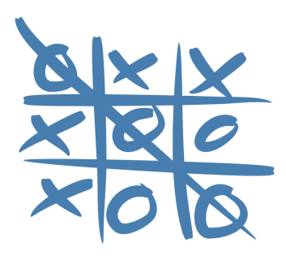
Game(Tic-Tac-Toe)
a paper-and-pencil game for two players •
Players take turns marking the spaces in a threeby-three grid with X or O.
Winner: who succeeds in placing three of their marks
a horizontal row
Vertical row
or diagonal row
Draw a flowchart

Slide 16
Review
Notes:
I conclude with the review of this week.

Slide 17
Next week
Review of an Object-oriented concept
ADT
Class
Abstract class
Interface
Generics
Parameter class having some undecided types
Notes:
Next week's lecture reviews Object-oriented concepts.
I think you already know ADT, Class, Abstract class, Interface, and so on, but I review them by illustrating how to take a more concrete shape from an ADT to instances step by step.
I also introduce the advanced object-oriented concept named generics, aka a parameterized class.
It allows us to defer the decision about the data type until its declaration.

Slide 18
Notes:
This is the end of the first class.
Thank you for your attention, and do not forget to check the exam board.

